Slide 1





Community-Powered Power Systems and Why They Work
Dr. John (“Sustainable Jack”) Martin
Lowlander Center
SustainableJack.com
Sky Power for the People, Inc.
Tuesday, June 16, from 3:30 to 5:00 p.m. MDT in Interlocken B
51ˢᵗ Annual Natural Hazards Research and Applications Workshop
June 14-17, 2026 | Broomfield, CO

Slide 2


A Product
A modular, portable, battery-powered 2-8 kw solar system that can be transported in a pickup truck or small trailer. It is scalable to multiple units with the size to meet the applications.
Suitable for everyday use, disaster response, and rentals. Rentals can be for homes, businesses, disaster situations, or special events.
A Process
A workshop with design, logistics, maintenance, and training community members. It can be completed in 20 hours or less.
Community members don’t need a massive amount of knowledge to build these units. The workshop is meant for novices with basic skills with hand tools and utilizes community resources. Building the units allows them to understand and service them later.

Slide 3
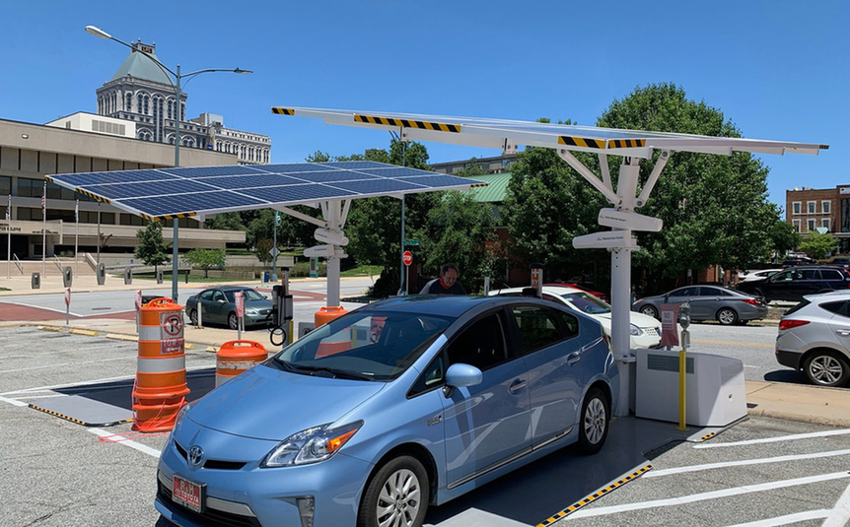
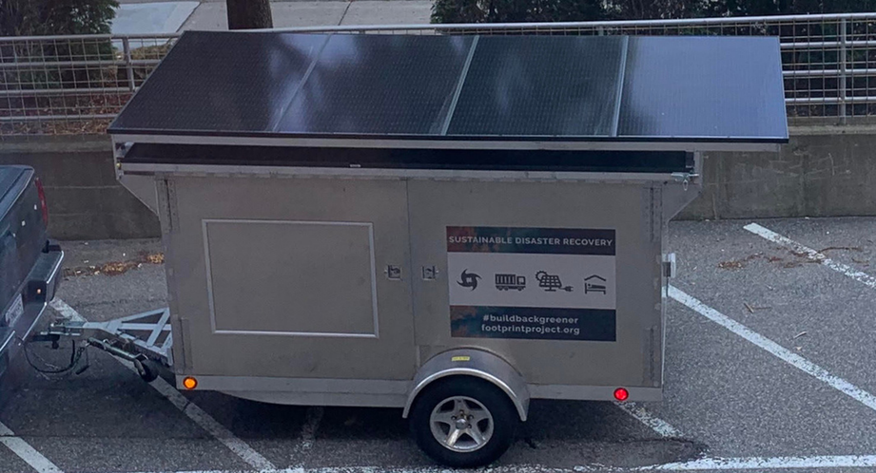
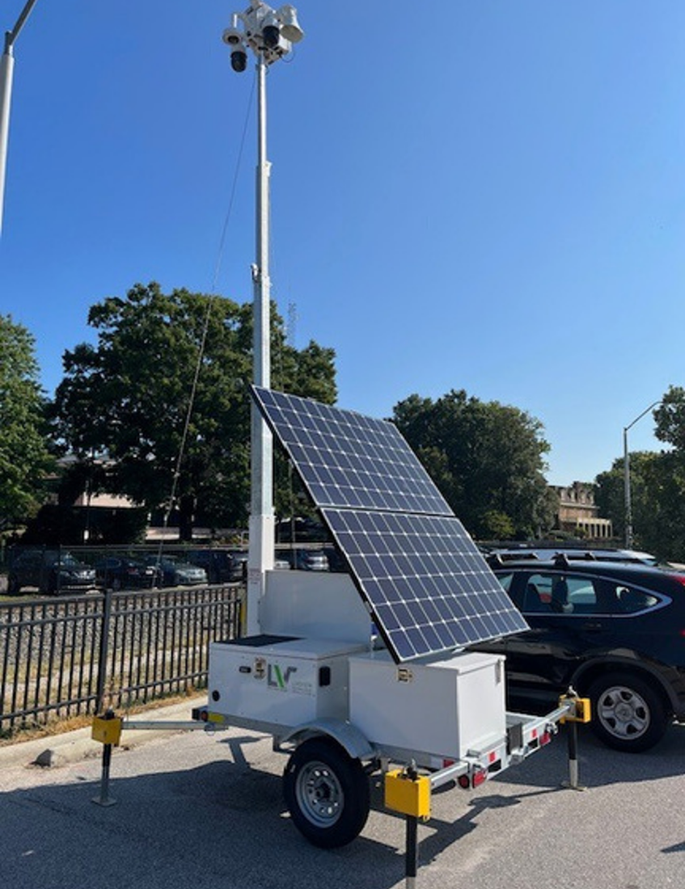
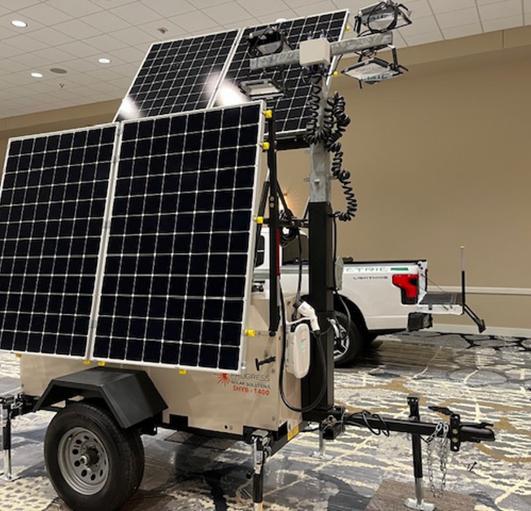
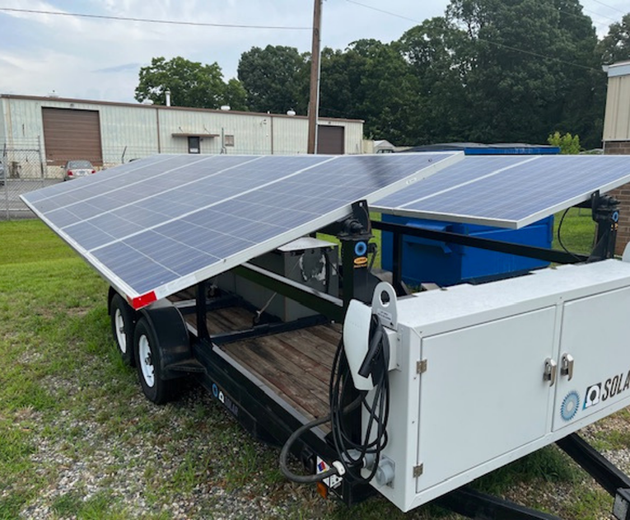
Commercial Portable Units Can Cost $30,000 and up
(~$10 per watt)

Slide 4
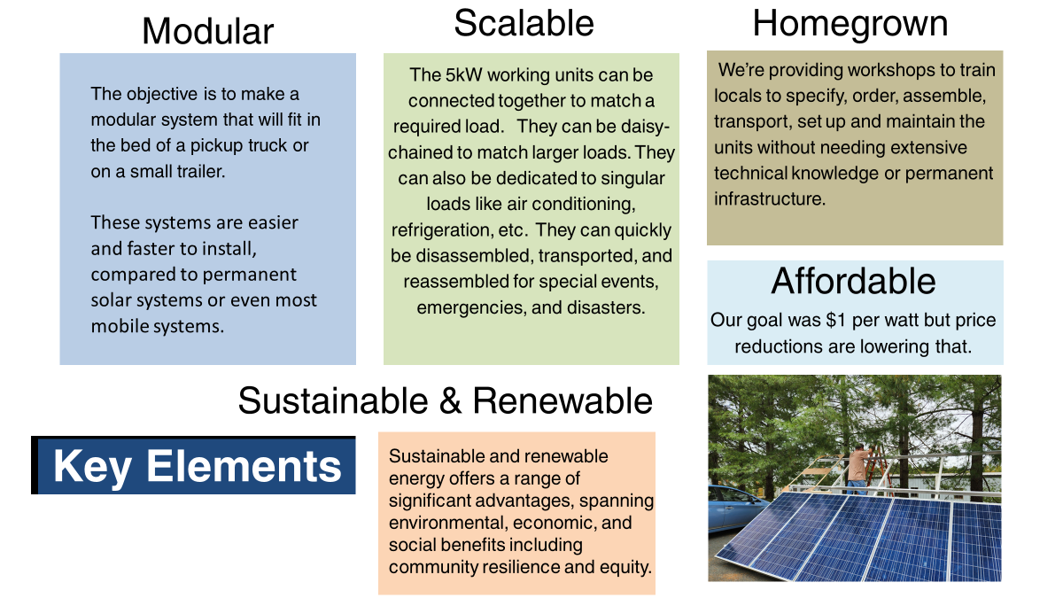
Sky Power for the People

Slide 5
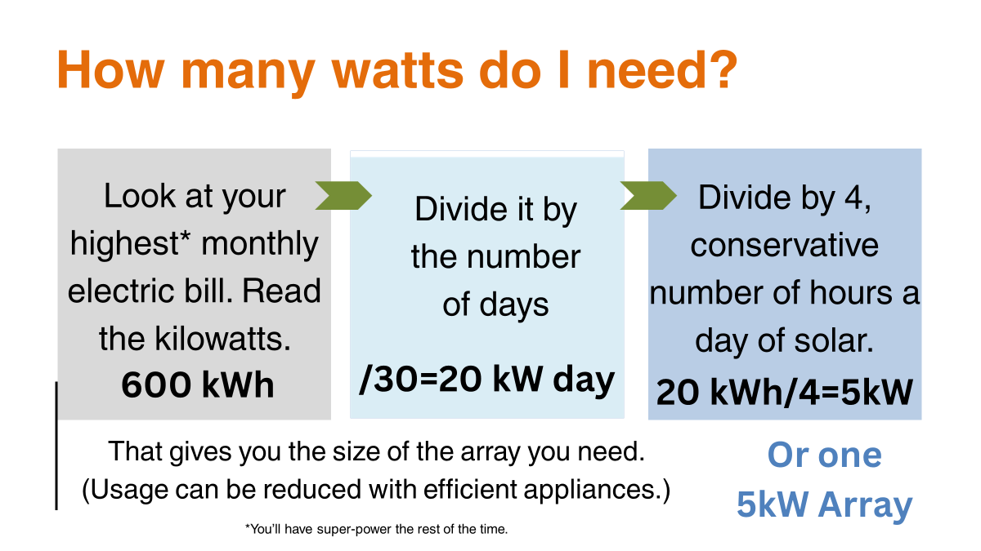

Slide 6
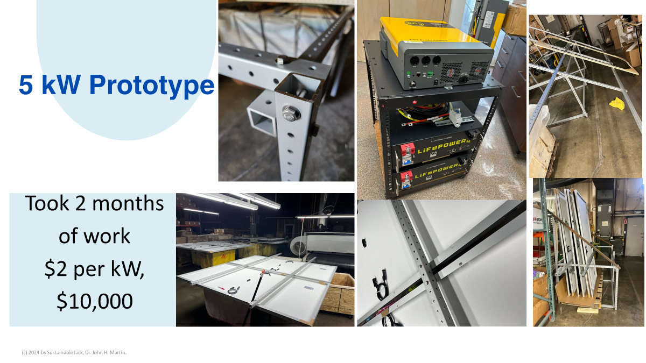

Slide 7
4.55 kWh Portable Solar · System Inventory & Costs
System components · Prices as of August 2024
Component | Spec | 1-unit qty | 1-unit cost | 3-unit qty | 3-unit cost
Solar panels | Solever 455w (2024) · 10 panels | 10 | $1,865.50 | 30 | $5,596.50
Inverter | EG4 3kW | 1 | $674.00 | 3 | $2,022.30
Batteries | 5 kWh | 1 | $1,495.00 | 3 | $4,305.00
Server rack | HT-W6412 | 1 | $100.00 | 3 | $300.00
Total (excl. racking) |  |  | $4,134.50 |  | $12,223.80
Racking tube inventory
80/20 Ready Tube 9701 · 1.50" × 1.50" square profile predrill · $0.56/in = $6.72/ft · Prices as of August 2024
Tube size | per unit | 1-unit cost | × 3 units | 3-unit cost
3 × 3 ft | 9 |  | 27
5 × 4 ft | 20 |  | 60
3 × 6 ft | 18 |  | 54
13 × 9 ft | 117 |  | 351
3 × 11 ft | 33 |  | 99
Total pieces | 197 |  | 591
Tube cost |  | $1,323.84 |  | $3,971.52
Hardware |  | $200.00 |  | $600.00
Racking total |  | $1,523.84 |  | $4,571.52
Prices as of August 2024 · 5 kWh battery option

Slide 8
4.55 kWh Portable Solar · Cost Reduction 2024 → 2026
August 2024
The world was
working against it...
June 2026
30% tax credits — gone
$5,559
1 unit
$4,230
1 unit
Import tariffs ↑
Additional taxes ↑
Inflation ↑
$1,866
$1,524
▼
$1,628
$1,916
34%
27%
− 24%
38%
45%
Solar Panels
Racking
Solar Panels
Racking
$1,495
$674
− $1,329
$251
$435
27%
12%
...and it won anyway.
6%
10%
Batteries
Inverter
Batteries
Inverter
Battery prices have fallen dramatically — 5 kWh option dropped from $1,495 (2024) to $251 (2026)

Slide 9
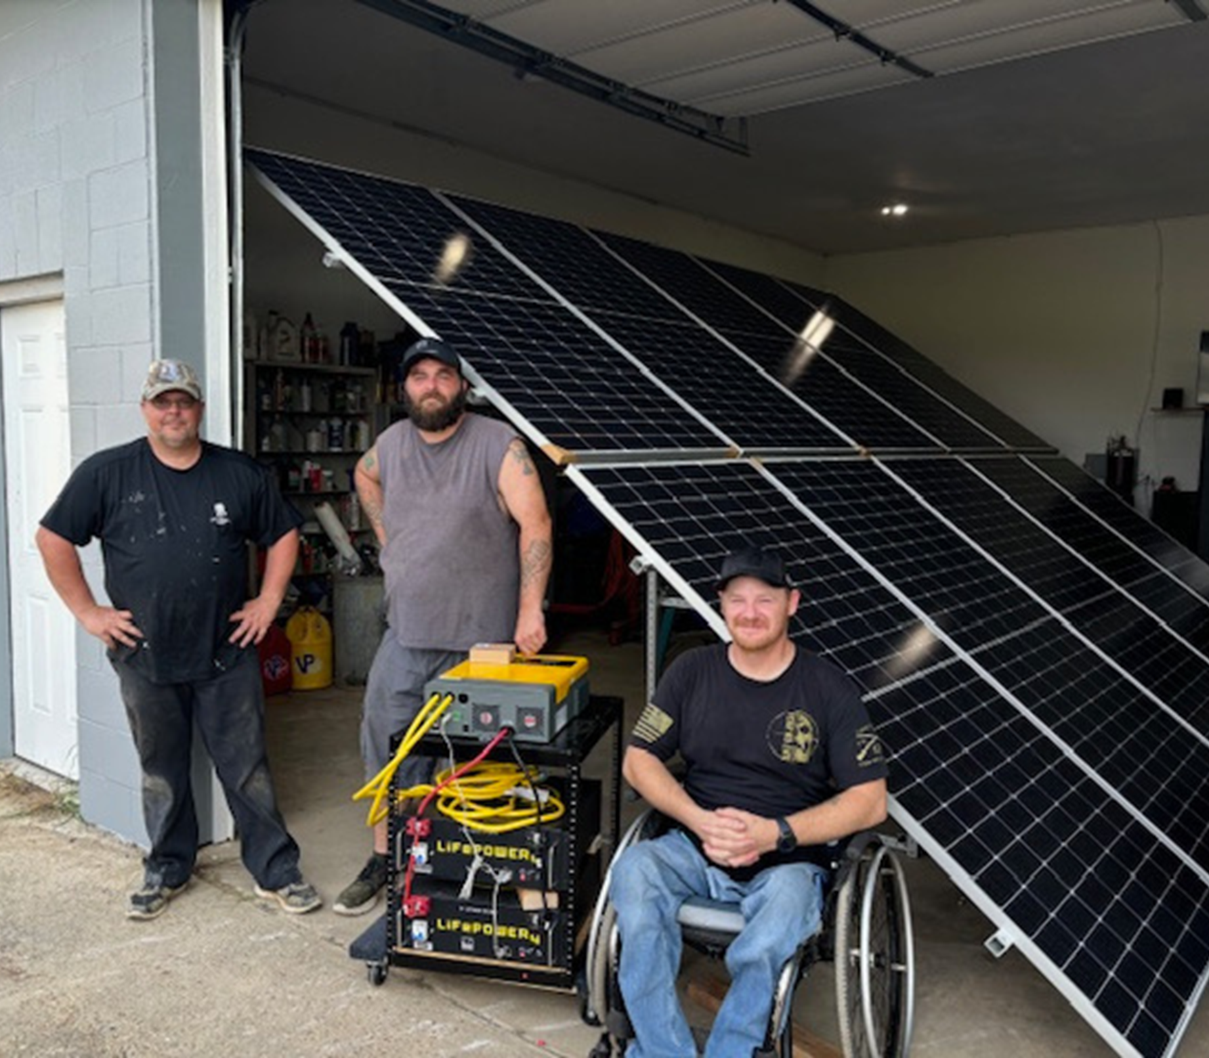
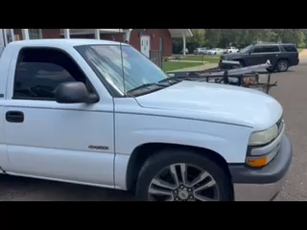

Built three portable units.
Two members have since sponsored their own workshops.
Accomplishments for first workshop
Demonstrated portability
(c) 2024 by Sustainable Jack, Dr. John H. Martin.

Slide 10
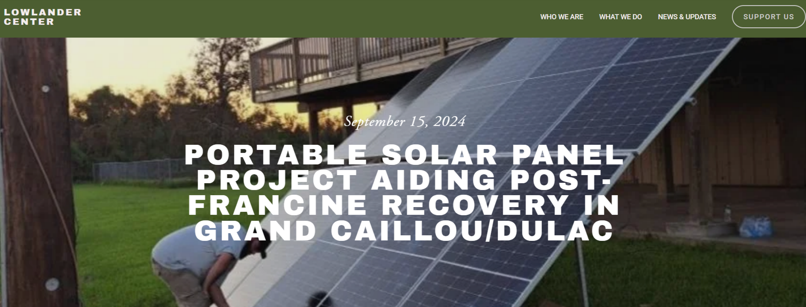
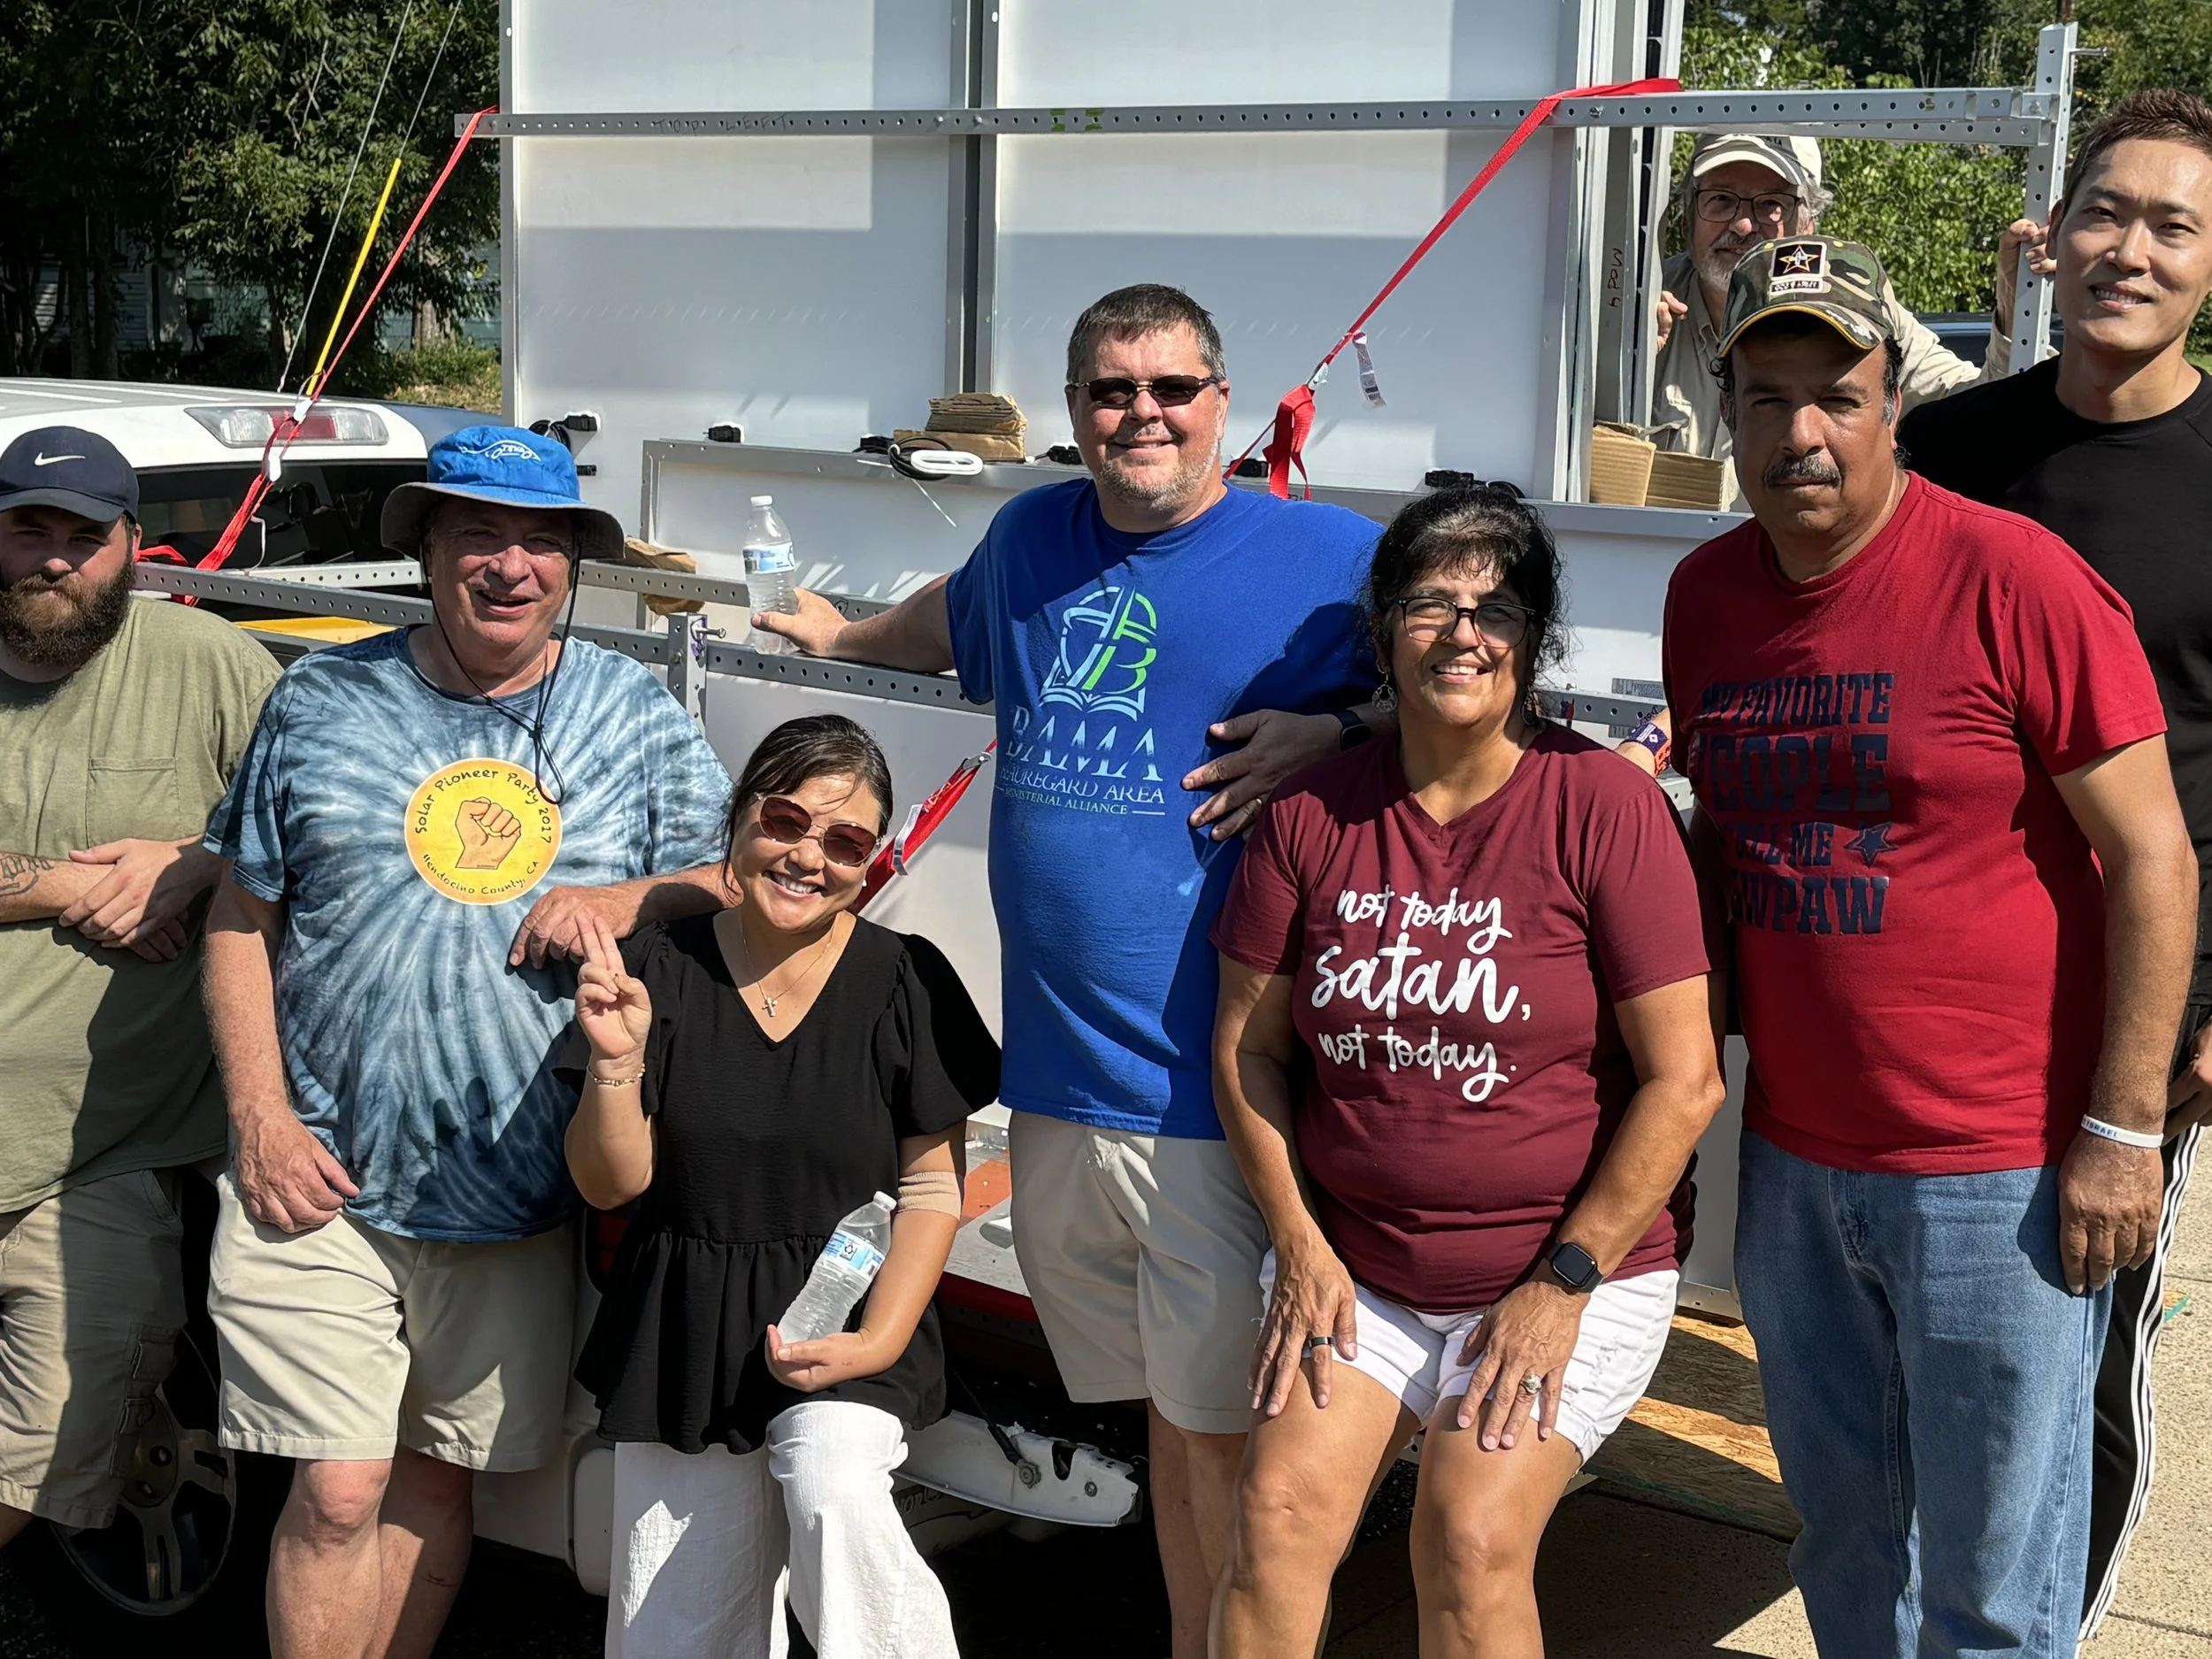
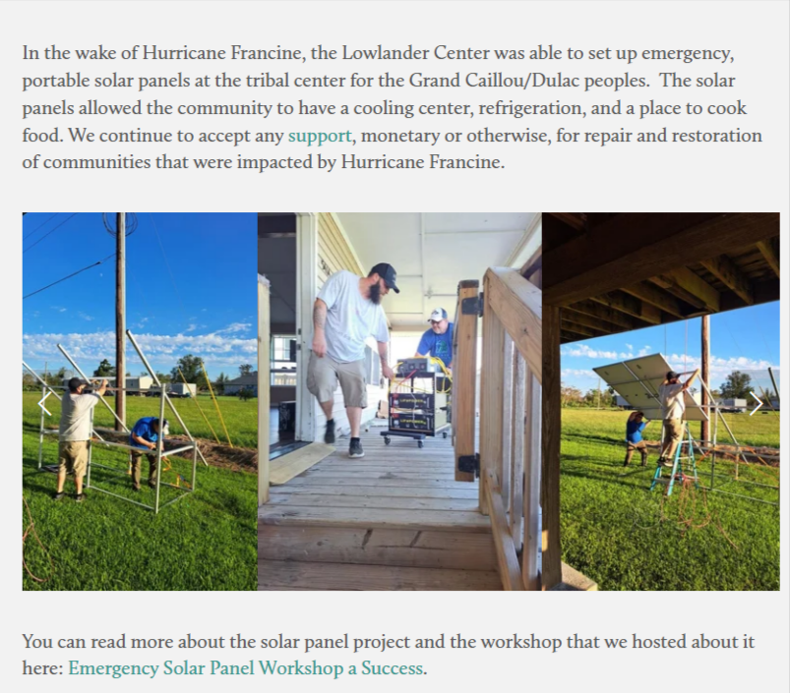
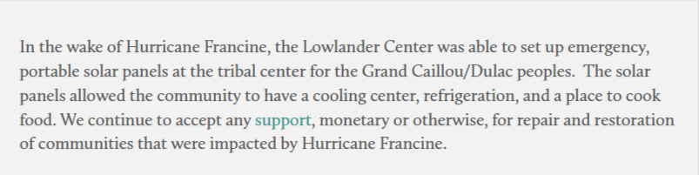
Proof of Concept
From the Lowlander Center Website. https://www.lowlandercenter.org/news-updates

Slide 11

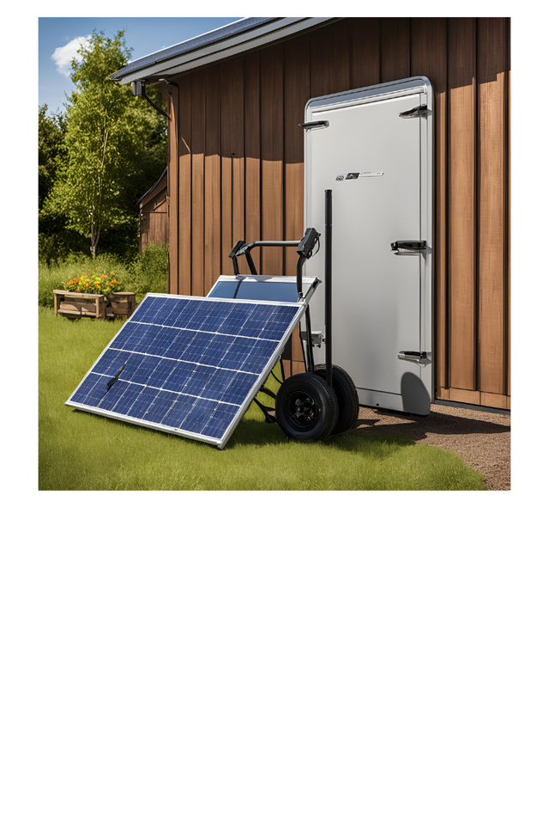
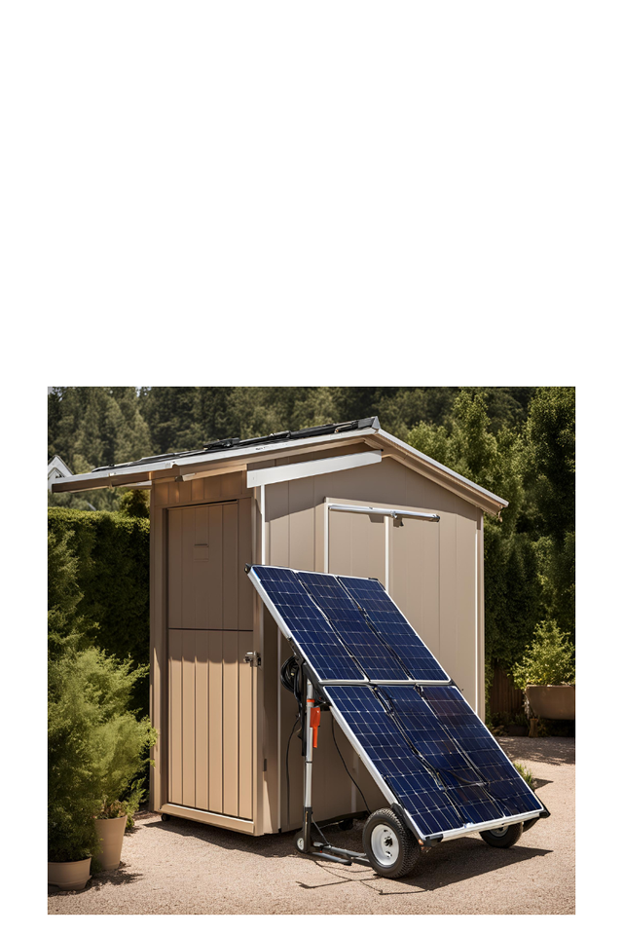
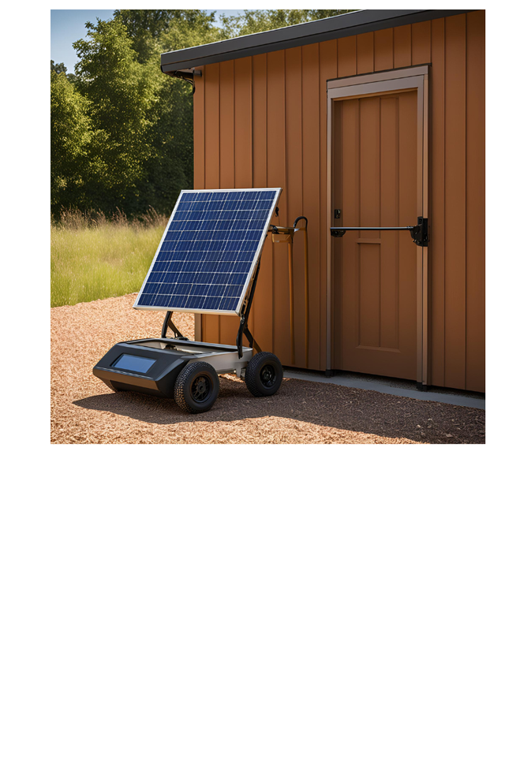
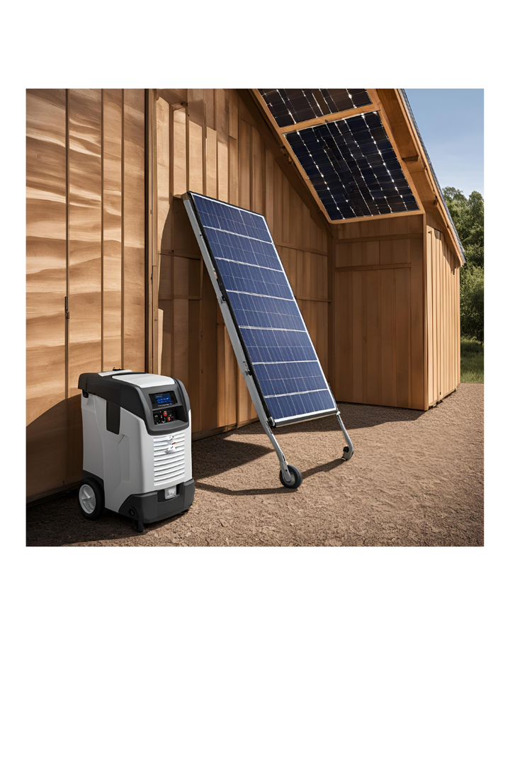

Evolving Future:
Designs of Systems and Next Stages of Project
Development

Slide 12
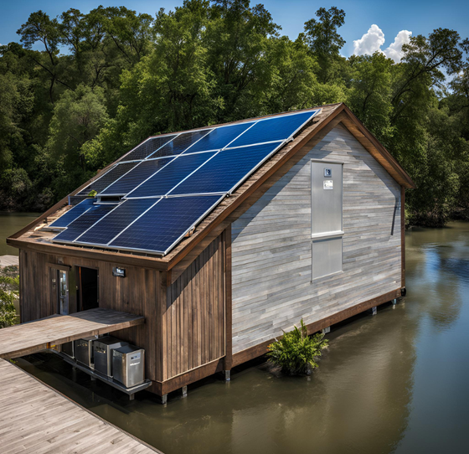
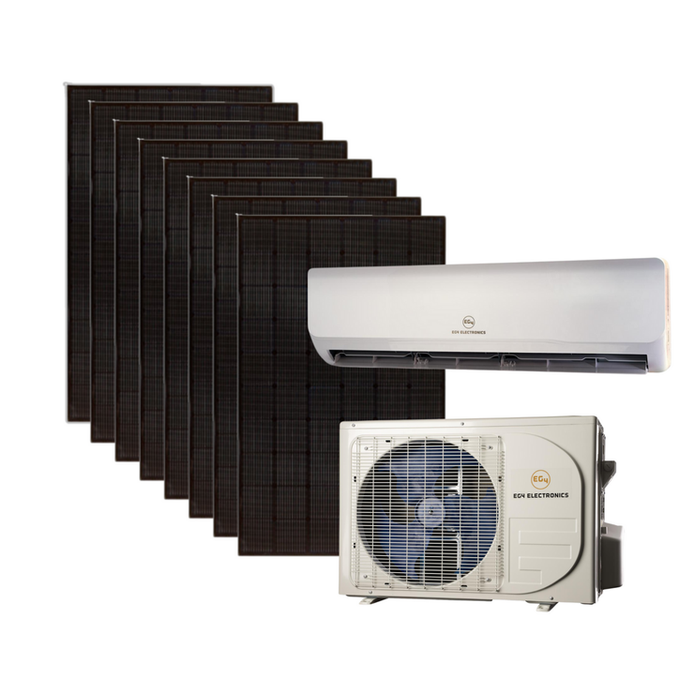

Upgrade 2 kWh BOS to 8kw
Upgrade from 10 panels to 8 panels
Upgrade training
Purchase examples of appliances
    air conditioners/heat pumps
    water pumps
    refrigerators
    ice makers and ice houses
    induction stoves
    water purifiers
    waste water aerators
    laundry washers
(c)

Slide 13

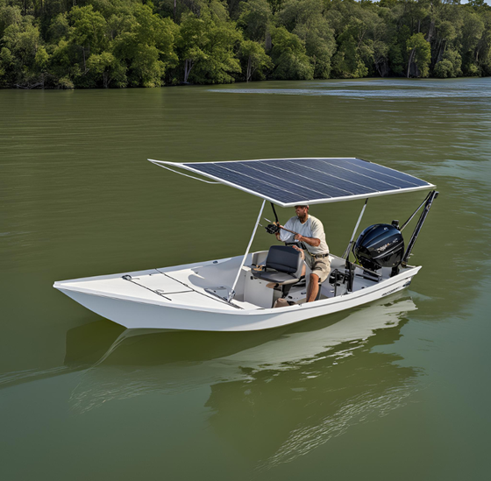
    20-foot TEU shipping containers of materials for disaster/emergency training
    Dog & pony show of pickup truck portable unit with trailer of deployed unit and rollout of 10 kWh BOS with 2-4 panels
    Share videos of units
    Power desalination units and aerator units for water purification
    Power skiffs and shanty boats with solar and wind

Slide 14

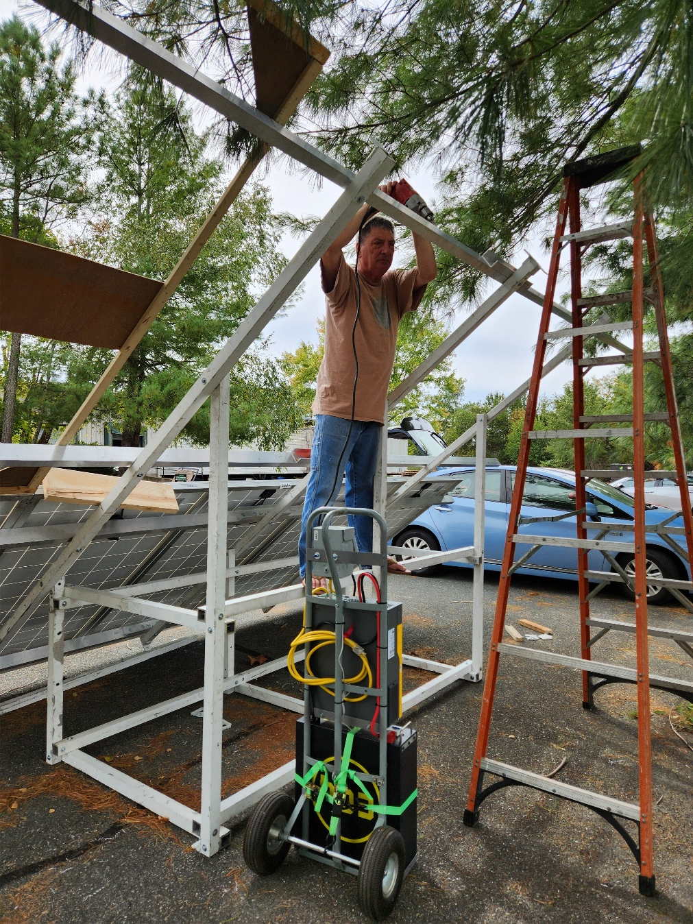

Thank You
*Sky Power to the People was first coined by Joe Jordan.
See his TEDx at: https://youtu.be/R1y2wll2Ve8?si=5l224gbk9CKg50gF

